Slide 1
String and Characters
String and Characters
Presented By : Nitish Vig

Slide 2


Basics
Single(‘’), Double(“”) quotes are used for single lines.
Tripe single(‘‘‘’’’), double (“““”””) quotes are used for multiple lines display and comments.
# (pound) sign is used for single line comment.
String and Characters
Presented By : Nitish Vig

Slide 3
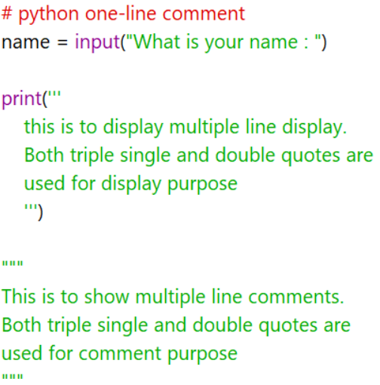
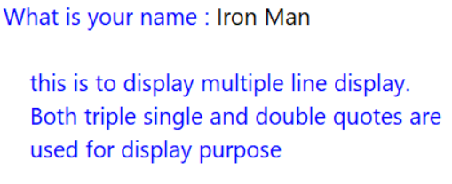
Basics
String and Characters
Presented By : Nitish Vig

Slide 4
operations
String and Characters
Presented By : Nitish Vig

Slide 5
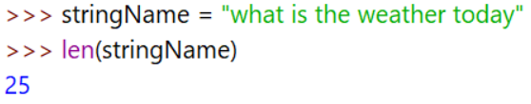
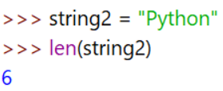
Length of String
Syntax : len(mainString)
It tells the total number of characters in the string(including space, of present).
String and Characters
Presented By : Nitish Vig

Slide 6
What is Indexing in Python?
Indexing in Python is a way to refer the individual items within an iterable by its position.
In Python, objects are “zero-indexed” meaning the position count starts at zero.
So, if there are 5 elements present within a list. Then the first element (i.e. the leftmost element) holds the “zeroth” place, followed by the elements in first, second, third, and fourth positions.
The Python Index Operator is represented by opening and closing square brackets: [].
The syntax, however, requires you to put a number inside the brackets.
SYNTAX
ObjectName[n] #Where n is just an integer number that represents the position of the element we want to access.

Slide 7
Negative Indexing in Python
The process of indexing from the opposite end is called Negative Indexing.
Note: In negative Indexing, the last element is represented by -1 and not -0.
letters = ['a', 's', 'd', 'f']
print(letters[-1])
print(letters[-2])

Slide 8
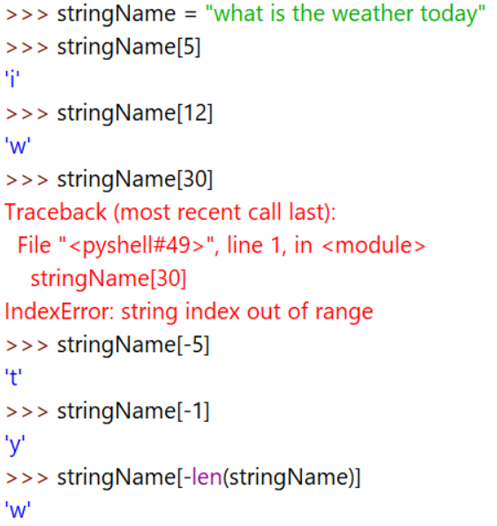
Indexing in String
Syntax : mainString[position]
It takes position number and displays the element in the string.
It can take both positive and negative value.
Positive sign means from left to right
Negative sign means from right to left
String and Characters
Presented By : Nitish Vig

Slide 9
Slicing the String
Python slicing can be done in two ways:
Using a slice() method
Using array slicing [ : : ] method
The slice() function returns a slice object.
A slice object is used to specify how to slice a sequence. You can specify where to start the slicing, and where to end. You can also specify the step, which allows you to e.g. slice only every other item.
Syntax:
slice(stop)
slice(start, stop, step)

Slide 10
start: Starting index where the slicing of object starts.
stop: Ending index where the slicing of object stops.
step: It is an optional argument that determines the increment between each index for slicing.
String = “Programming with Python”
# Using slice constructor
s1 = slice(3)
s2 = slice(1, 5, 2)
s3 = slice(-1, -12, -2)
print(“String slicing”)
print(String[s1])
print(String[s2])
print(String[s3])
String = “Programming with Python”
print("String slicing")
print(String[slice(3)])
print(String[slice(1, 5, 2)])
print(String[slice(-1, -12, -2)])

Slide 11
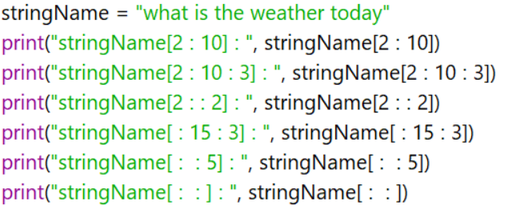
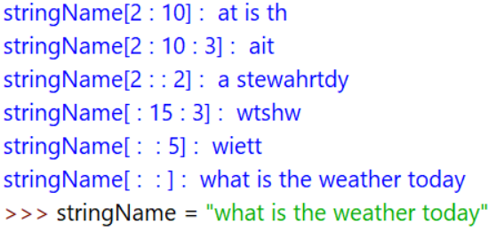
Slicing the String
Syntax : mainString[start : end : stepSize]
It trims the string between starting and ending points.
Stepsize default value is 1.
String and Characters
Presented By : Nitish Vig

Slide 12
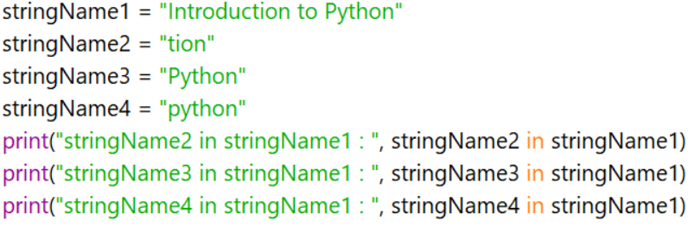
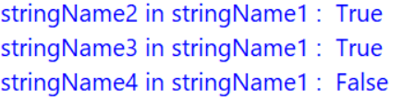
Checking membership in Strings
Syntax : substring ‘in’ mainString;
substring ‘not in’ mainString
It helps to check if substring is in mainString.
“ in ” and “ not in ” Operator.
String and Characters
Presented By : Nitish Vig

Slide 13
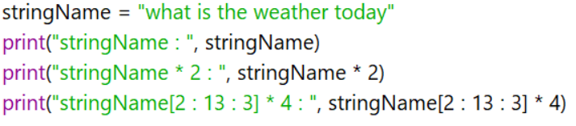
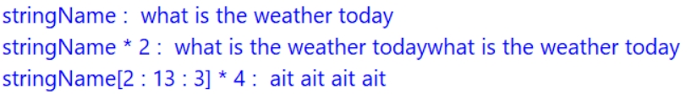
Repeating the String
Syntax : mainString * integer
It repeats the strings with respect to integer value.
String and Characters
Presented By : Nitish Vig

Slide 14
The count() method returns the number of occurrences of a substring in the given string.
The syntax of count() method is:
string.count(substring, start=..., end=...)
message = “python is popular programming language”
print('Number of occurrence of p:', message.count('p'))
count() method only requires a single parameter for execution.
However, it also has two optional parameters:
substring - string whose count is to be found.
start (Optional) - starting index within the string where search starts.
end (Optional) - ending index within the string where search ends.

Slide 15
txt = “Python is popular programming language I like Python” x = txt.count(“Python”, 5,55) print(x)

Slide 16
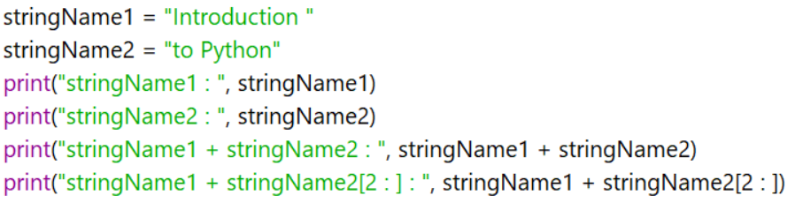
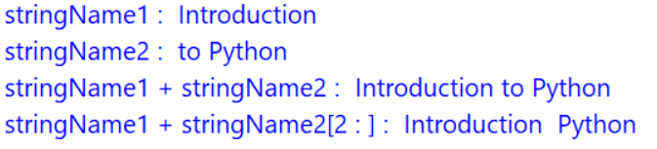
Concatenation of Strings
Syntax : mainString1 + mainString2
It adds two strings and show a single statement.
String and Characters
Presented By : Nitish Vig

Slide 17
Removing spaces in Strings
Syntax : mainString.lstrip()
mainString.rstrip()
mainString.strip()
It helps remove black spaces either from left side,
or, from right side,
or, from both sides of the string.
It don’t remove spaces between the strings.
String and Characters
Presented By : Nitish Vig

Slide 18
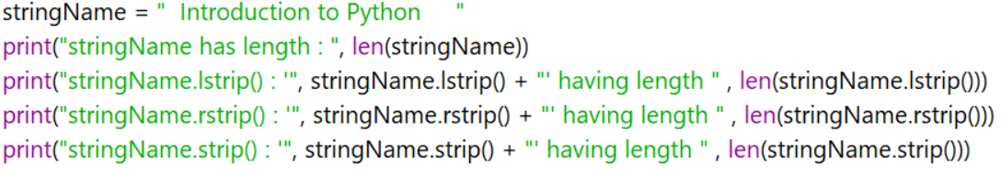
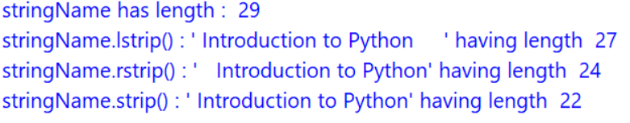
Removing spaces in Strings
String and Characters
Presented By : Nitish Vig

Slide 19
Finding sub-Strings in mainString
Syntax : mainString.find(substring, Beginning, Ending)
mainString.index(substring, Beginning, Ending)
It returns the first occurrence of substring in mainString.
The output is an integer number or Error (if, not found)
String and Characters
Presented By : Nitish Vig

Slide 20
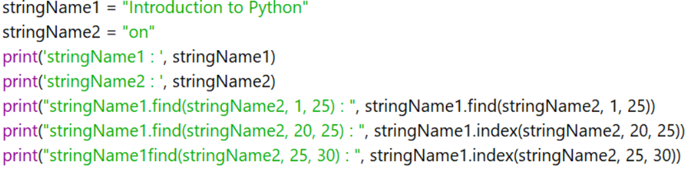
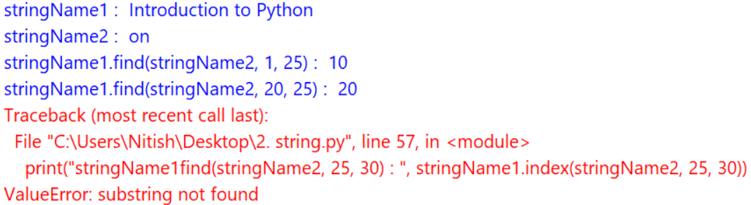
Finding sub-Strings in mainString
String and Characters
Presented By : Nitish Vig

Slide 21
Counting sub-Strings in mainString
Syntax : mainString.count(substring, Beginning, Ending)
It returns the number of times of occurrence of subString in mainString.
The output is an integer number or Error (if, not found)
String and Characters
Presented By : Nitish Vig

Slide 22
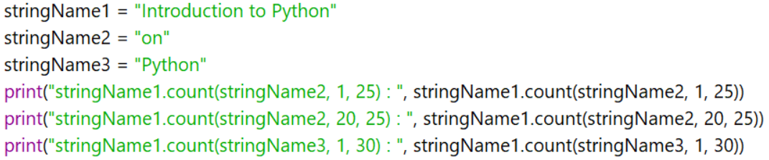
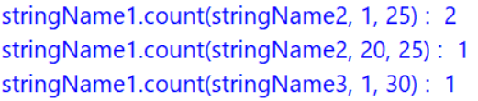
Counting sub-Strings in mainString
String and Characters
Presented By : Nitish Vig

Slide 23
Replacing one string with another String
Syntax : mainString.replace(oldString, newString)
It replaces the old string with new one in the entire string.
String and Characters
Presented By : Nitish Vig

Slide 24
Changing cases of the String
Syntax : mainString.upper()
mainString.lower()
mainString.swapcase()
mainString.title()
Upper() converts string to the UPPERCASE string
lower() converts string to the LOWERCASE string
swapcase() converts lowercase characters to uppercase and vice-versa
title() converts every first character of the word in entire string to uppercase and rest are lowercase.
String and Characters
Presented By : Nitish Vig

Slide 25
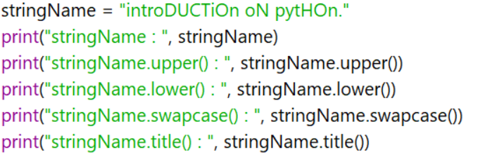
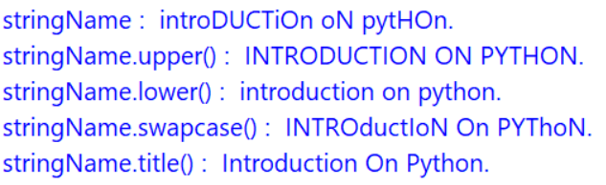
Changing cases of the String
String and Characters
Presented By : Nitish Vig

Slide 26
Splitting and Joining of Strings
Syntax : mainString.split(“separator”)
“separator”.join(mainString)
Splitting operation breaks the strings into pieces on the basis of separator and returns list.
Joining operation fill the gap between elements on the basis of separator.
Separator can be any alphabet, number, special character…
String and Characters
Presented By : Nitish Vig

Slide 27
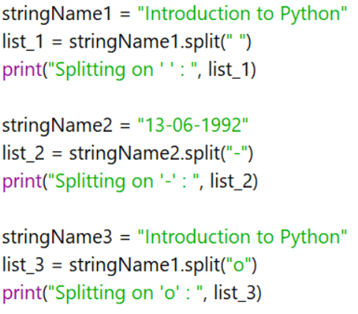
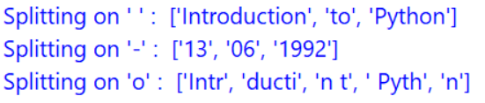
Splitting and Joining of Strings
String and Characters
Presented By : Nitish Vig

Slide 28
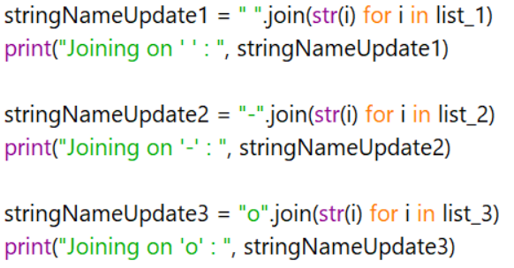
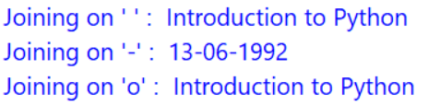
Splitting and Joining of Strings
String and Characters
Presented By : Nitish Vig

Slide 29
Checking starting and ending in String
Syntax : mainString.startswith(subString)
mainString.endswith(subString)
startswith() check if mainString is starting with subString.
endswith() check if mainString is ending with subString.
It returns True or False.
String and Characters
Presented By : Nitish Vig

Slide 30
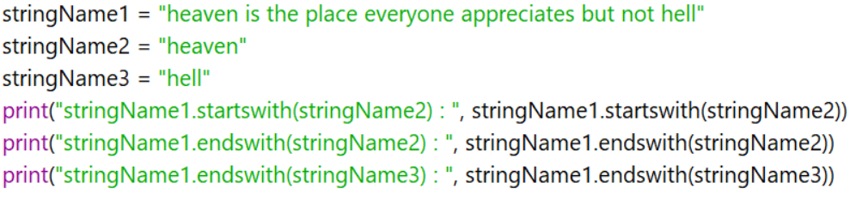
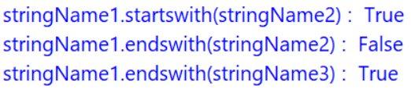
Checking starting and ending in String
String and Characters
Presented By : Nitish Vig

Slide 31
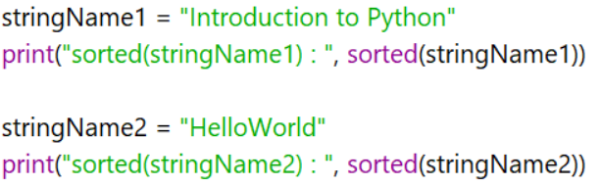
Sorting of String
Syntax : sorted(mainString)
It will return sorted string in the form of list.
String and Characters
Presented By : Nitish Vig

Slide 32
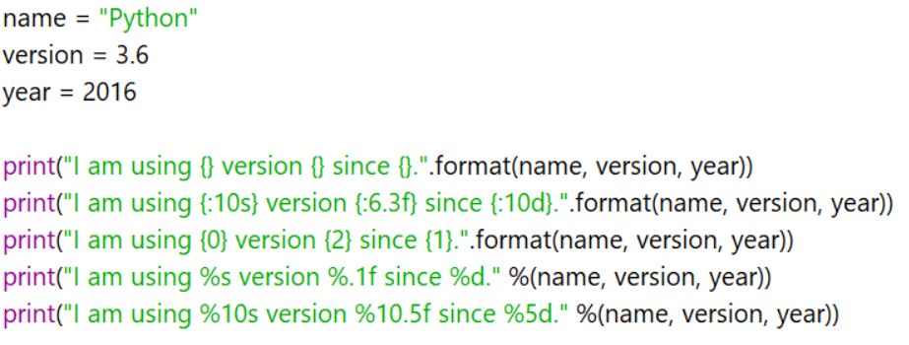
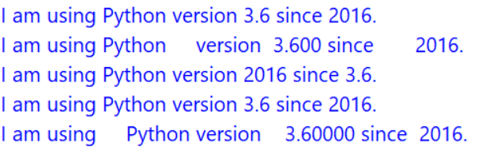
Format of String
It helps to display the message with respect to value placed in output(print) message.
String and Characters
Presented By : Nitish Vig

Slide 33
String Test Methods
Syntax :
mainString.isalnum()
mainString.isalpha()
mainString.isdigit()
mainString.islower()
mainString.isupper()
mainString.istitle()
mainString.isspace()
Returns True, if all characters are alphanumeric (0-1, a-z, A-Z).
Returns True, if all characters are alphabets (a-z, A-Z).
Returns True, if all characters are numbers (0-9).
Returns True, if all characters are in lowercase (a-z).
Returns True, if all characters are in uppercase (A-Z).
Returns True, if all characters are in title.
Returns True, if only spaces are there.
String and Characters
Presented By : Nitish Vig

Slide 34
String and Characters
Presented By : Nitish Vig

